Slide 1
Data-Driven Methods in Image Processing
CMPUT 206
Nilanjan Ray

Slide 2
What is a data-driven method?
I don’t think there is a rigorous definition!
Loosely speaking, if an algorithm relies on a lot of data during run-time to accomplish a task, it is referred to as a data-driven method
In the next few lectures, we will study some examples:
De-noising
Texture synthesis
Super resolution
Image inpainting
Object removal

Slide 3
De-noising
We will first study a famous de-noising method called bilateral filter
Next, we will study a method called non-local means which is a generalization of bilateral filter
Finally, we will take a look at BM3D method

Slide 4
Bilateral filtering setup
Let I and J be the input and output of the bilateral filtering, respectively.
Let (i, j) denote a pixel location.
Let N(i, j) denote set of neighboring pixels of (i, j); Note, N(i, j) includes pixel (i, j) as well.
Let w((i, j), (m, n)) denote non-negative weight assigned to pixel pairs (i, j) and (m, n).
How do we create this weights? Relationship with Gaussian filtering?

Slide 5
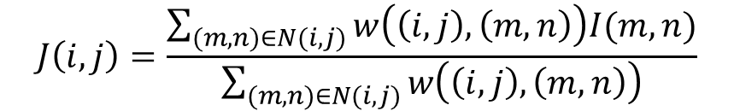

Bilateral filtering
$$J\left(i,j\right)=\frac{\sum_{(m,n)∈N(i,j)}{w\left(\left(i,j\right),\left(m,n\right)\right)I(m,n)}}{\sum_{(m,n)∈N(i,j)}{w\left(\left(i,j\right),\left(m,n\right)\right)}}$$
Weight depends
on gray/color values
$$w\left(\left(i,j\right),\left(m,n\right)\right)=exp⁡(−\frac{{(i−m)}^{2}+{(j−n)}^{2}}{α})exp⁡(−\frac{{(I(i,j)−I(m,n))}^{2}}{β})$$
In comparison, Gaussian filter weights are independent of gray/color values:
$$w_{g}\left(\left(i,j\right),\left(m,n\right)\right)=exp⁡(−\frac{{(i−m)}^{2}+{(j−n)}^{2}}{α})$$

Slide 6
Bilateral filtering examples
Input image
Gaussian filter
bilateral filter
Bilateral filter is able to preserve edges; but Gaussian filter failed; why?

Slide 7

Why Gaussian filter cannot preserve edges?
edge pixel gray value diminished!
edge pixel
*
=
Input
$$exp⁡(−\frac{{(i−m)}^{2}+{(j−n)}^{2}}{α})$$
Output
Weighted average
operation

Slide 8
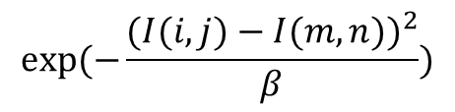

Why bilateral filter preserves edges?
edge pixel
*
x
$$exp⁡(−\frac{{(i−m)}^{2}+{(j−n)}^{2}}{α})$$
$$exp⁡(−\frac{{(I(i,j)−I(m,n))}^{2}}{β})$$
Almost no change at edge pixel!
=

Slide 9
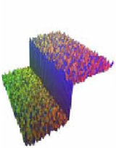
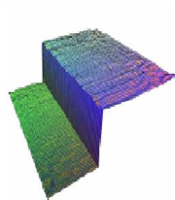
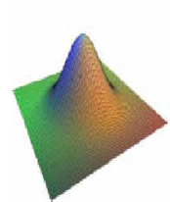
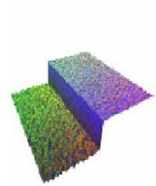
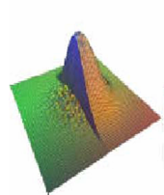
Bilateral filter weights in 2D
input
Output
W_{c}
W_{s}
W_{s}*W_{c}
Slide source: http://faculty.cs.tamu.edu/jchai/csce441_2015fall/

Slide 10
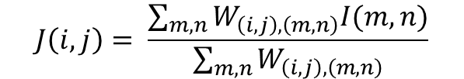
Nonlocal means filtering
Let us denote input image by I and output image by J, as before
For every pixel location (i, j), consider a small image patch around it; call it P_{i, j}
Find out similar patches P_{m, n} centered at pixel locations (m, n)
Consider weight between (i, j) and (m, n) as
W_{(i, j), (m, n)} = exp(-||P_{i, j} - P_{m, n}||²/s), s is a user input parameter
Output image is calculated by
$$J\left(i,j\right)= \frac{\sum_{m,n}{W_{\left(i,j\right),\left(m,n\right)}I(m,n)}}{\sum_{m,n}{W_{\left(i,j\right),\left(m,n\right)}}}$$
As we can see here that the mean is a weighted non-local mean

Slide 11
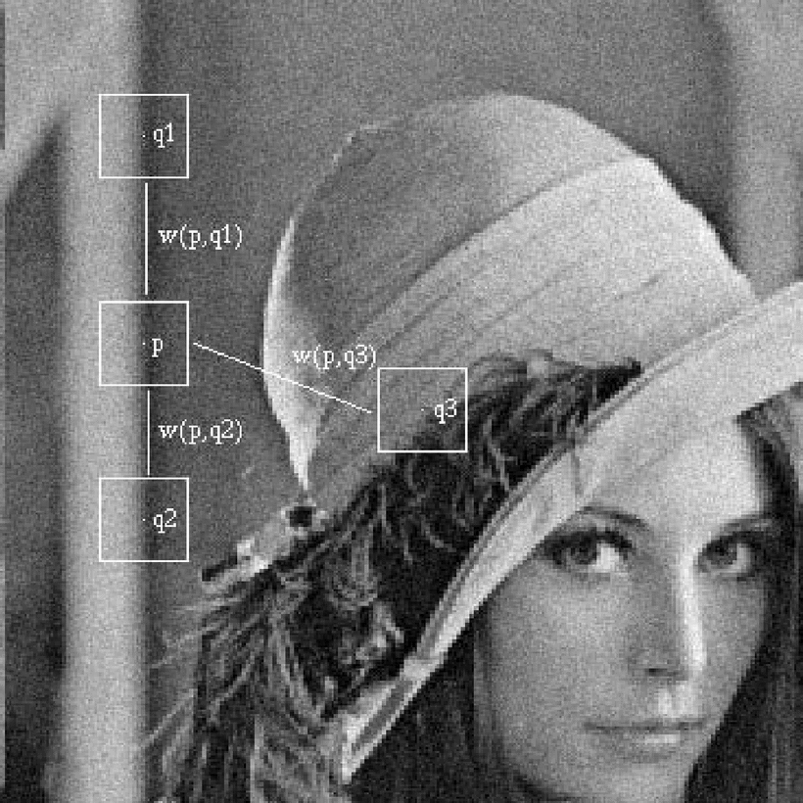
NL means filtering…
w(p, q1) and w(p, q2) would be large
w(p, q3) would be small
Source: A. Buades, B. Coll and J. M. Morel, "A non-local algorithm for image denoising," Computer Vision and Pattern Recognition, 2005. CVPR 2005. IEEE Computer Society Conference on, 2005, pp. 60-65 vol. 2. doi: 10.1109/CVPR.2005.38

Slide 12
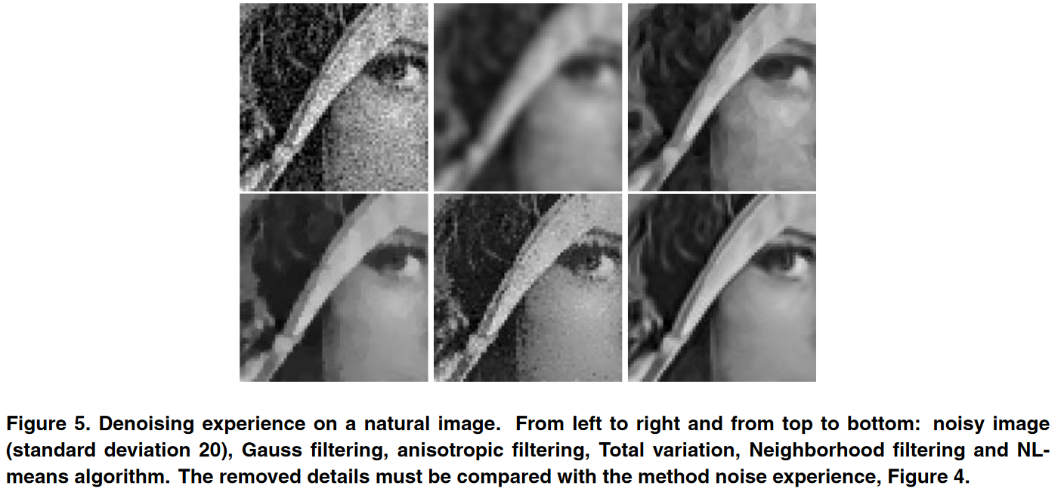
NL filtering result with some comparisons
Source: A. Buades, B. Coll and J. M. Morel, "A non-local algorithm for image denoising," Computer Vision and Pattern Recognition, 2005. CVPR 2005. IEEE Computer Society Conference on, 2005, pp. 60-65 vol. 2. doi: 10.1109/CVPR.2005.38

Slide 13
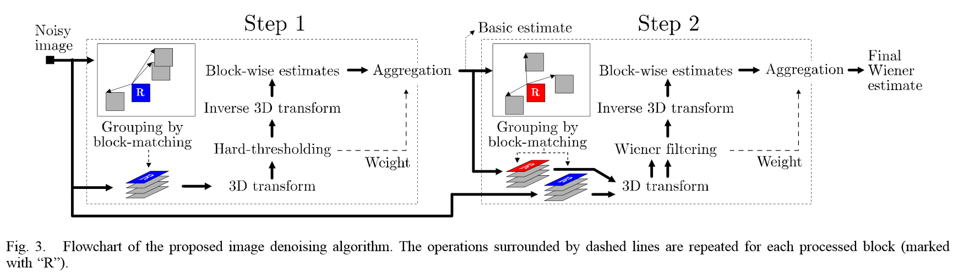
BM3D: Block matching and collaborative filtering
Picture source: http://www.cs.tut.fi/~foi/GCF-BM3D/BM3D_TIP_2007.pdf

Slide 14
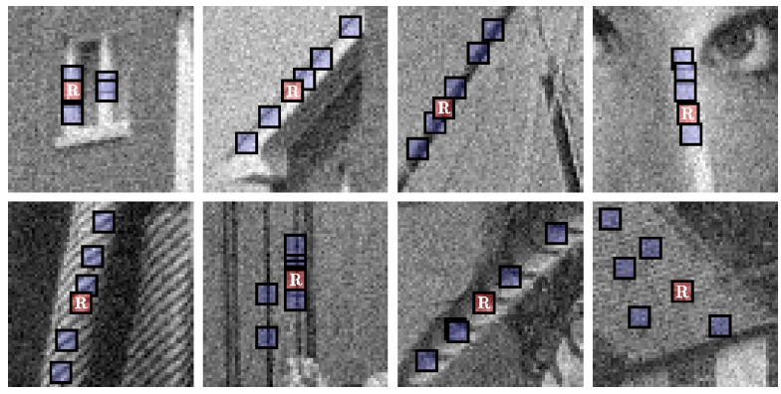
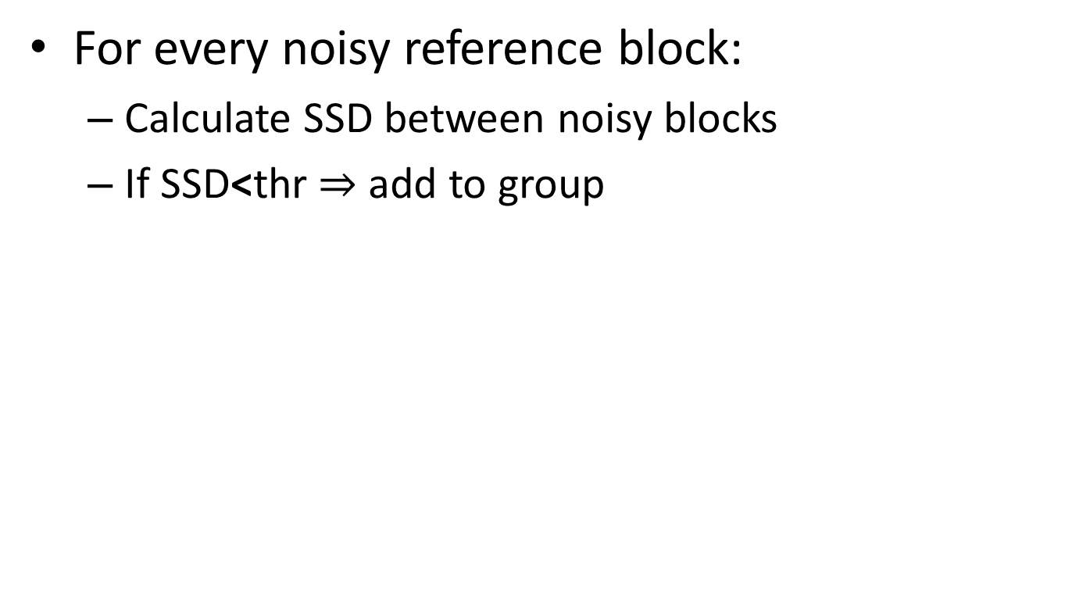
Grouping by Block Matching
For every noisy reference block:
Calculate SSD between noisy blocks
If SSD<thr $⇒$ add to group
Picture source: http://www.cs.tut.fi/~foi/GCF-BM3D/BM3D_TIP_2007.pdf

Slide 15
3D transform + collaborative filtering
Apply wavelet transform to 3D blocks
Apply hard thresholding to wavelet coefficients
Apply inverse wavelet transform to obtain de-noised 3D blocks

Slide 16
Fusion of de-noised 3D blocks
Blocks are merged by suitable weights obtained from previous filtering steps

Slide 17
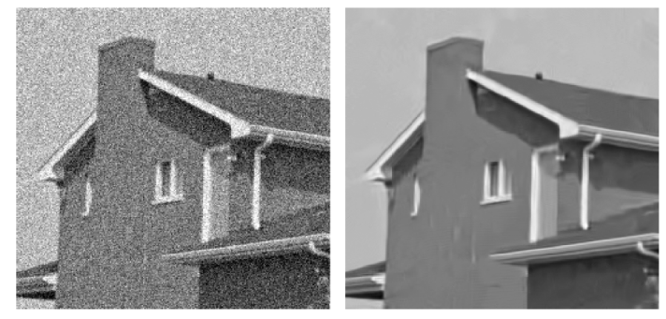
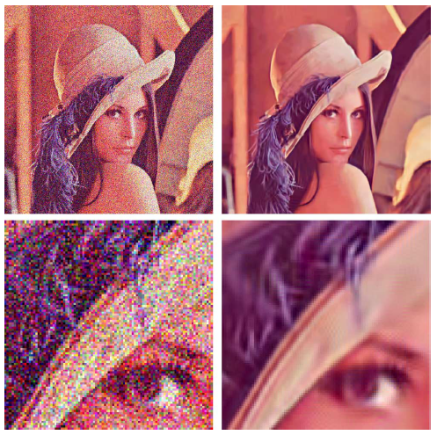
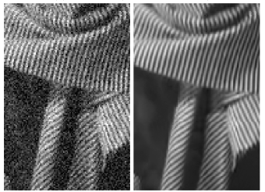
BM3D examples
Picture source: http://www.cs.tut.fi/~foi/GCF-BM3D/BM3D_TIP_2007.pdf

Slide 18
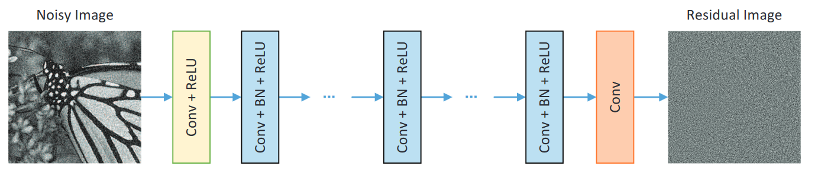
Deep learning-based denoising
https://arxiv.org/pdf/1608.03981.pdf
Deep learning achieves state-of-the-art results in image denoising today!

Slide 19
Next lecture
Data-driven texture synthesis

